Slide 1
RLS Adaptive Filter – Audio Equalizer
James Salvatore
May 9,2015 Nidhal Bouaynaya

Slide 2
Recursive Least Squares Algorithm
Used for denoising desired signals that are known
But if a desired message is known, why filter it???
We know the noise around the message – ah, different!
For such filters, the message is recorded with a constant noise in the background: this noise is our filter’s desired signal!
Instead of being the filter’s output, the filtered message is the error output, while the noise is the filter’s output.
Notes:
The message is what we want to know (and that could be anything!), but since we know what the noise is, this is our desired signal.

Slide 3
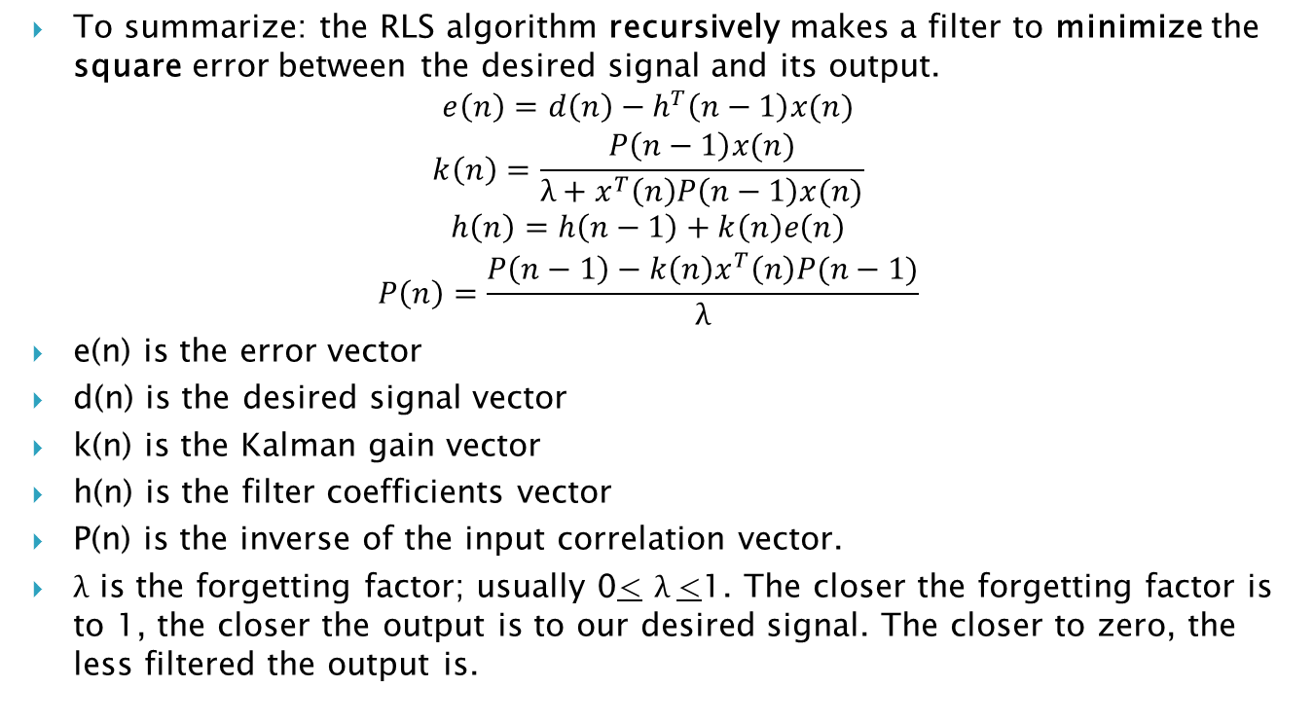
Carry Out This Criss-Cross
To summarize: the RLS algorithm recursively makes a filter to minimize the square error between the desired signal and its output.
$$e\left(n\right)=d\left(n\right)−h^{T}\left(n−1\right)x(n)$$
$$k\left(n\right)=\frac{P\left(n−1\right)x(n)}{λ+x^{T}\left(n\right)P\left(n−1\right)x(n)}$$
$$h\left(n\right)=h\left(n−1\right)+k\left(n\right)e\left(n\right)$$
$$P\left(n\right)=\frac{P\left(n−1\right)−k\left(n\right)x^{T}\left(n\right)P(n−1)}{λ}$$
e(n) is the error vector
d(n) is the desired signal vector
k(n) is the Kalman gain vector
h(n) is the filter coefficients vector
P(n) is the inverse of the input correlation vector.
$λ$ is the forgetting factor; usually 0< $λ$<1. The closer the forgetting factor is to 1, the closer the output is to our desired signal. The closer to zero, the less filtered the output is.

Slide 4

The Audio Equalizer

Slide 5
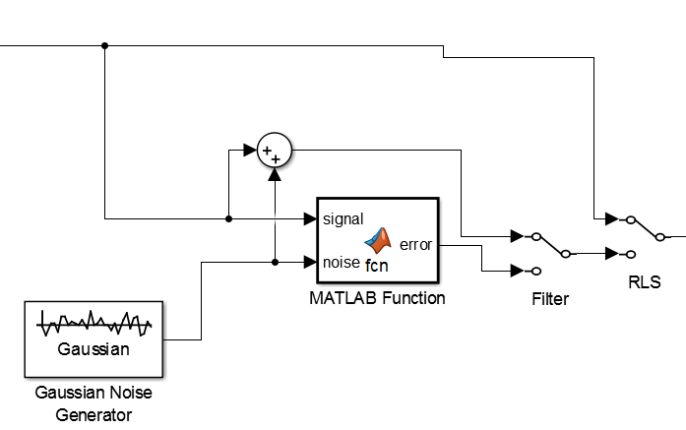
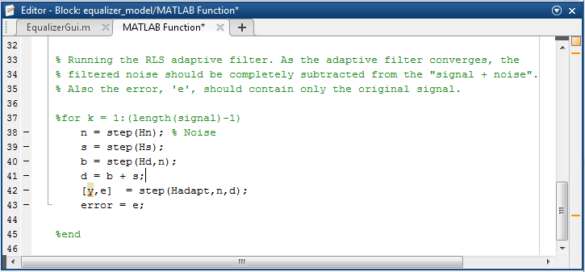
RLS Adaptive Filter Design Demo
MATLAB Demo Copyright 1999-2013 The MathWorks, Inc.

Slide 6
References
MathWorks. Adaptive Noise Cancellation Using RLS Adaptive Filtering. [Online]. Available: <http://www.mathworks.com/examples/matlab-dsp-system/2396-adaptive-noise-cancellation-using-rls-adaptive-filtering>.
Signal Processing Society – Connecticut Section, Chapter 6: Random Signals, [Online]. Available: <https://ewh.ieee.org/r1/ct/sps/PDF/MATLAB/chapter6.pdf>
Wenhua, Wang, and Wang Hongyu. “Recursive Least Squares Algorithm for Nonstationary Random Signal.” IEEE Xplore. IEEE, 18 Oct. 1996. Web. 7 May 2015.

